Slide 1
The distance problem
60 dBA
48 dBA
54 dBA
42 dBA
32 ft.
16 ft.
8 ft.
4 ft.
A typical teacher’s voice measures 60-65dB at a distance of four feet – only enough for the front row to hear clearly!

Slide 2
Effects of noise and distance
A classroom with 50dB of background noise
Word recognition
100
90%
75%
80
40%
10%
60
typical classroom noise
40
20
0
10
20
30
40
distance from the teacher in feet

Slide 3
What are the characteristics of low and high tones?
60 dBA
4 feet
60
low tones
contain speech
power
high tones
contain speech
information
50
40
30
125
250
500
1000
2000
4000
8000
frequency in hertz
Notes:
While low tones carry speech energy and volume, they contribute little to the intelligibility. I’ll demonstrate.” [play low frequency clip; audience will probably have trouble understanding what was said]

Slide 4
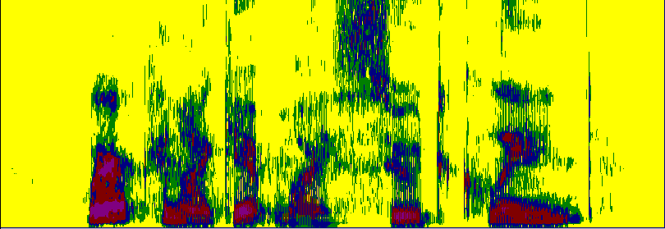
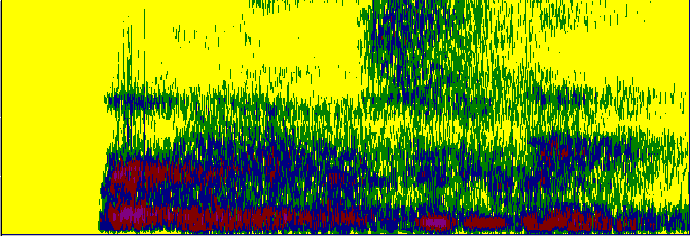
Reverberation
Where
can I
get my
suit
cleaned?
8
6
Output
from
talker
4
2
0
Frequency in kHz
8
Input
to
listener
6
4
2
0
0.0
0.2
0.4
0.6
0.8
1.0
1.2
1.4
1.6
1.8
Time in seconds

